Slide 1
Comprehensive Quantitative Structure-Activity Relationship model utilizing Machine Learning to predict the bioactivity of molecular inhibitors against Thrombin.”
Manh Tuong Nguyen
Ananya Guptac
Shwethal Sayeeram Trikannad
Jennifer Melendez
Professor Wesley
Bioinformatics 123A

Slide 2
Our Project Focus
Our research project aims to develop a Quantitative Structure-Activity Relationship (QSAR) model using machine learning algorithms to predict the bioactivity of molecular inhibitors against Thrombin, an endogenous procoagulant protein whose increase is linked to Coronary Artery Disease[1], Deep Vein Thrombosis[2] and Stroke[3] among others. We will curate a robust dataset of the bioactivity of compounds that target Thrombin. We will attempt to identify Lipinski molecular descriptors and structural features using advanced machine learning techniques. Our goal is to create a predictive model that not only speculates the bioactivity of untested compounds but also provides valuable insights into the rational design of more effective thrombin inhibitors. This interdisciplinary study integrates computational methods with medicinal chemistry, paving the way for advancements in targeted drug design for cardiovascular diseases.

Slide 3
What is thrombin?
Thrombin belongs to the trypsin family of serine proteases which is an enzyme in the human body that is encoded by the F2 genes.
Thrombin is a unique enzyme in which function both as a procoagulants and anticoagulants.
Thrombin is synthesized in the liver and it is secreted in the general circulation of an inactive form of zymogen which is a complex multi domain glycoprotein that is activated to yield thrombin at sites in which there is vascular injury.
Thrombin is Na+ activated, allosteric serine protease thats plays opposing functions roles in blood coagulation.

Slide 4
Thrombin background
Thrombin is an enzyme in which involves in digestion and degradative processes, blood coagulation, cell mediated immunity and cell death.
Once generated in the blood its acts as an inactive precursor prothrombin. Thrombin plays two important roles and paradoxically opposing function.
It acts as a procoagulant factor when it converts fibrinogen into an insoluble fibrin clot that anchor platelets to the site of lesion and initiates process of wound repair.
Thrombin cleaved osteopontin, which is a multifunctional molecular regulating chronic inflammation and vascular disease.
It acts as an proteolytically to induce monocyte on its RGD sequence and promote the migration of cells through the extracellular matrix. Which is a basic activity which required the embryonic development and tumor metastasis.

Slide 5
How is thrombin prepared?
Thrombin is prepared in the blood plasma.The preparation itself only takes three steps.
- Isolution of prothrombin from plasma
- Activation to thrombin
- purification of the mature enzyme from the activation mixture

Slide 6
Negative role of thrombin
High concentration of thrombin seem to contribute to the pathological processes during neurodegenerative diseases. Such as provoking:
Stroke
Hemorrhage
Multiple sclerosis
Alzheimer and parkinson diseases
Stroke
Coronary artery disease
Deep vein thrombosis
It also provokes hypersensitivity, bleeding, anemia, postoperative wound infection, thromboembolic events, hypotension, pyrexia, tachycardia and thrombocytopenia in an individual.

Slide 7
Coronary Artery Disease
Coronary artery disease is considered a heart diseases in which blood vessel that supply the heart struggle to send enough blood, oxygen and nutrients to the heart muscle.
Coronary artery disease occur when fats, cholesterol and other substance collect on the inner walls of the heart arteries. Preventing any flow through those blockage.
Beside high cholesterol other factors that take place would be diabetes or insulin resistance, high blood pressure, not getting enough exercise, and/ or smoking tobacco.
Reduced blood flow to the heart can cause chest pain and shortness of breath.
A complete blockage of blood can cause a heart attack.
Signs and symptoms for coronary artery disease is chest pain, shortness of breath, fatigue, and heart attack.
Risk for coronary artery disease id overweight, physical inactivity, unhealthy eating and a family history of CAD is also a great risk factor because of genetics.

Slide 8
How does thrombin incorporate into Coronary Artery Disease?
Thrombin is considered a potential tool to improve risk factor for people that have cardiovascular disease such as CAD.
Thrombin generation is assessed with the method Calibrated automated thrombogram at 1 through 5 pM tissue factor that triggered in creating platelet that are poor in the plasma. For the reason that there was a thrombin generation curve the lag time with the endogenous thrombin potential had reached a peak height.
Thrombin generation is the enzymatic key process that direct the activity of the hemostatic system and coagulation cascade up to create the formation of a fibrin clot.
Large scales of study determine that traditional cardiovascular risk factor, such as obesity are relevant determinants of thrombins generation.

Slide 9
Deep Vein (Thrombosis Symptoms and causes)
DVT occurs only where a blood clot forms in the deep veins in the body usually the legs. A reason in which the blood clot can form is for the reason that the body itself doesn't have much movement or physical activity.
DVT can form when there isn't much movement when your in bed rest due to a surgery.
Deep Vein thrombosis is a very serious disease in which hard blood clots can break loose. Those clots itself can travel through the bloodstream and get stuck anywhere between the lungs or an important system in which produces a pulmonary embolism. Having both a DVT and a pulmonary embolism can cause an venous thromboembolism.

Slide 10
How does Thrombin incorporate into Deep Vein Thrombosis?
Thrombin itself clots blood by activating platelets and chopping up protein in which is called fibrinogen to form fibrin. Fibrin itself is essential for blood clot contraction.
It helps with the shrinkage of clots, it also plays an important role in hemostasis, wound healing and the restoration of flow through the obstructive thrombi.
Thrombin generation is based upon the individual's blood composition. It is associated with the risk of thrombosis and may be a useful predictive marker for evaluating thrombosis on an individual.

Slide 11
Ischemic Stroke ( Symptoms and causes)
An ischemic stroke is the cause of a lack of blood supply to the brain. Either there is a blockage or reduction of oxygen.
The prevention of oxygen to the brain tissue lacks the brain from receiving the right nutrients which causes the brain tissue to die within minutes.
Symptoms of a given stroke is trouble speaking and understanding what others are saying. A person having a stroke might seem disoriented or confused.
Numbness or weakness in the face, arm or leg is an indicator that an individual is having a stroke. This specific type of stroke affects one side of the body to the point where paralysis starts going into effect.
An individual might seem to lack sight in either one or both eyes. There vision may suddenly change to the point where there vision blackens or goes into complete blur.
Trouble walking is also a strong indicator because an individual start losing balance and they may stumble or lose balance as they are walking.

Slide 12
How does Thrombin incorporate into a stroke?
Thrombin is involved in a stroke pathology through many ways .
Such as direction cellular toxicity, vascular disruption, oxidative stress or inflammatory responses.
Increase thrombin activity and concentration are brutal for neuronal health. Thrombin has a significant role in the nervous system. Low levels of thrombins activity and concentration promote brain tissue viability, synaptic plasticity and having a protective effect when it comes the excitotoxic detrimental factors.
During the acute phase of cerebral infarction the synaptic plasticity is altered through the activation of N - Methyl D Aspartate receptors which can induce long terms of ischemic synaptic transmission.
High level of thrombin activity and concentration during the acute stages of ischemic stroke contribute to the neurovascular injury which activate risk factors of ischemic stroke.

Slide 13
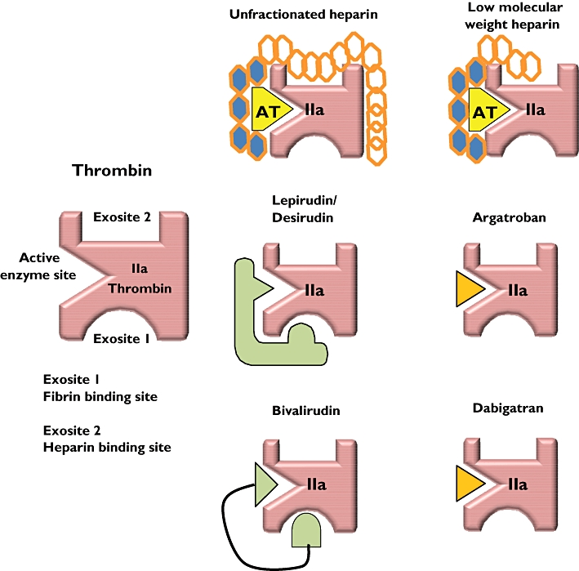
What drugs inhibit thrombin?
Drugs that inhibit thrombin would be:
Lepirudin
Desirudin
Bivalirudin
Argatroban
Dabigatran
Heperin

Slide 14
How does the drug inhibit Thrombin?
Thrombin has schematic interaction with 6 anticoagulants.
Direction thrombin inhibitors bind directly to the thrombin and does not require any antithrombin to exert their effect.
DTI can inhibit both soluble and insoluble which is thrombin and fibrin bound thrombin.
Heparin being one of the anticoagulants has a key advantage because of there lack of binding to other plasma protein, an anti platelet effect and the absence of immune mediated thrombocytopenia.
All anticoagulants have been investigated for treatment to VTE, percutaneous coronary intervention, acute coronary syndrome.

Slide 15
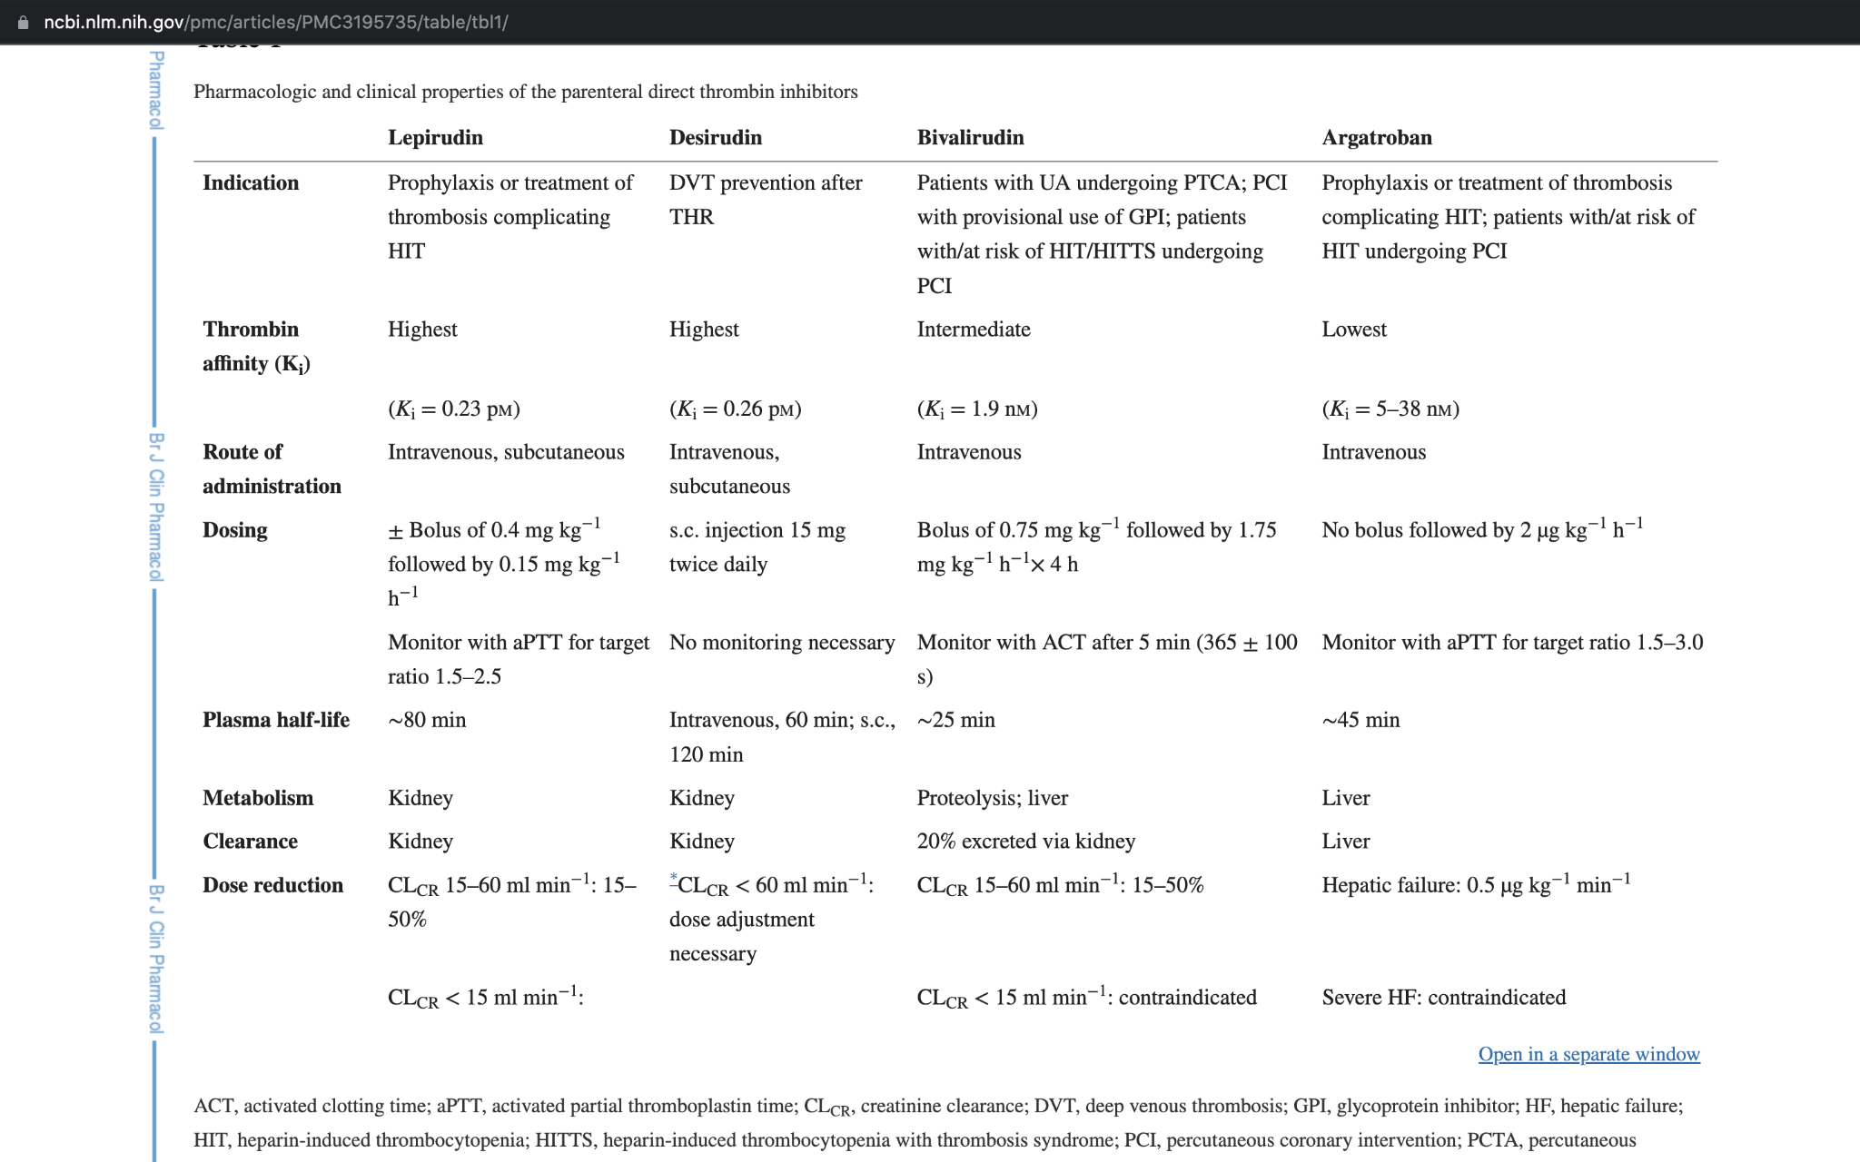

Slide 16
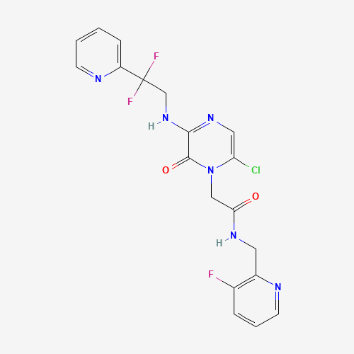
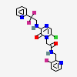
Thrombin Conical Smiles
Molecular Formula: C19H16ClF3N6O2
Canonical Smile: C1=CC=NC(=C1)C(CNC2=NC=C(N(C2=O)CC(=O)NCC3=C(C=CC=N3)F)Cl)(F)F

Slide 17
Lipinski molecular descriptors
Lipinski has a rule of 5 :
It minimize the ligand of the molecular weight. Lipinski has a compound in which its approach has a limit of 500 daltons.
There is an optimization of permeability and uptake. Small Molecular target telomeric or promoter which transverse both the other and the nuclear membrane.
Ester groups can be cleaved by cellular esterases so avoidance of grouping that are already metabolized and also avoid those that inherit the chemical instability.
Avoidance of groups that can be significantly toxic to the cell.
There has to be a fair assumption that systematic screening is ranged in a neurological and cardiac relevant assay which can be undertaken through the few compound that have undergone a pre clinical development such as RHSP4, AS1410 and quarfloxin. There is a need for an off target toxicity so there isn't a publicly available document for the quadruplex ligands.

Slide 18
Machine - learning (ML) techniques
Machine learned has been increasingly used for the reason that it provides os many suitable outcome to an individual's project.
It has been increasingly been used in numerous stages of drug design such as identifying target.
Improves small molecular compound design and optimization
Develop new markers for drug efficiency.
There are two techniques when it comes to machine learning: Supervised and unsupervised. Supervised learning method developed training model for predictive purposes on a known dataset while unsupervised method is more on exploration and clustering the data.

Slide 19
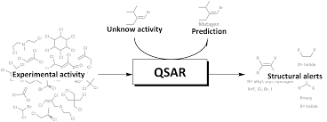
Qsar Models
Qsar is a model in which produces predictions models that are derived from application of statistical tools that are relating to biological activities.
It's considered a statistical tool in which its applying model is related to the chemical structure of compound to there bioactivity.
Qsar model gives the ability to use variable forms of numerical descriptors and represent the chemical structure in which analyzes the relationship between the bio activity of the compound and using the predictive model.

Slide 20
Algos being used in the project
Random forest regression : is considered a supervised learn algorithm. It's a bagging technique that uses a learning method for regression in machine learning. Its an effective method when you want to estimate the missing data and maintain accuracy when a large portion of the data is missing.
PCA : A principal component analysis is a dimension approach. In which it construct linear combination of gene expression called principal component. PCA can effectively explain variation of gene expression and can explain variation in lower dimensionality. PCA is a statistical procedure that allows the summarization of information in large data tables by the means of a smaller set of summary indices that can be more easily analyzed.

Slide 21
Algos being used
Svm: The support vector machine approached a representation which is a data driven method in which solves classification task. A SVM is a machine learning algorithm that uses supervised learning models to solve classification, regression and outlier detection problems by performing optimal data transformation that has boundaries between data point based on classes, labels and outputs,
Gradient boosting regression: GBR is a representation that is based on an idea in which assemble method that derive from a decision tree. Its a tree structure in which branches accordingly to the conditions towards the leaves and the goals leaf is the prediction result.

Slide 22
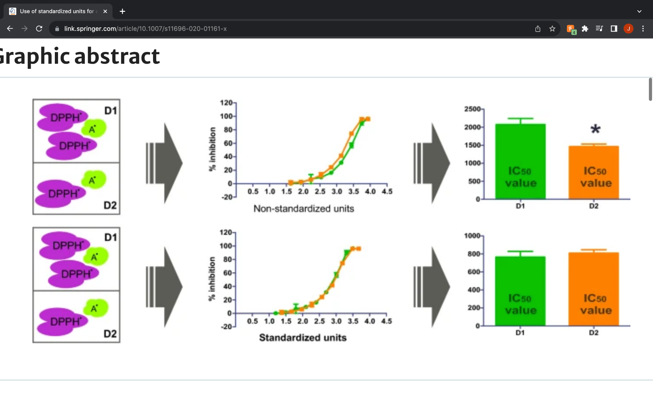
Standard Value IC50
The standard value IC50 is the most used activity type.
It has an inhibitory concentration 50%
The molar concentration of antagonist/ inhibitor that reduces the response to an agonist by 50%

Slide 23
Future improvement
There are various avenues for future work and improvements in a project of this scale and type. Additional molecular descriptors that might encompass unique aspects of thrombin antagonism including descriptors specific to thrombin interaction could be utilized to get more efficacious and potent lead candidates. An exhaustive exploration of hyperparameter tuning for the Random Forest Regressor and optimization of the model's performance by systematically tuning parameters such as the number of trees and minimum samples per leaf could be performed. mbalances as seen in the present dataset with inactive compounds surpassing the active ones could be corrected by applying techniques such as oversampling, under sampling, or utilizing advanced algorithms designed for imbalanced datasets like balanced random forests can be investigated. Cross validation of the machine learning models can be carried out to reduce bias, overfitting and estimate performance. Experimental validation of the identified thrombin antagonists with the help of biological assays performed by skilled researchers will definitely reinforce the reliability of the QSAR model's predictions.

Slide 24
Conclusion
In Conclusion, The research used a rigorous computational method to predict the bioactivity of thrombin inhibitors, as well as a suite of statistical and machine learning technologies. Despite the intrinsic complexity of biological interactions, the use of several regression models, such as the well-known DecisionTreeRegressor and NuSVR, provides useful insights into the prediction of molecular bioactivity for train and test respectively. The study highlights the difficulties of predictive modelling in bioinformatics, but it also lays the door for future advancements through methodological modifications and the incorporation of more advanced biological datasets. This initiative is a first step towards developing more precise and computationally efficient models in the search for new medicinal drugs.

Slide 25
The end

